Slide 1

KharchaTrack
Smart Expenses Tracker With Insight
By Reman buddhacharya

Slide 2
Introduction
KharchaTrack is a web-based expense tracker for personal finance management.
Built using Laravel and Livewire for real-time monitoring with predictive analytics.
Features expense forecasting and anomaly detection for better financial decisions.

Slide 3
Problem Statement
Traditional expense tracking methods are time-consuming and lack deeper insights into spending patterns.
Many individuals struggle with identifying unusual transactions that may indicate fraud or errors.
Existing expense trackers primarily focus on recording transactions without providing forecasting or anomaly detection capabilities.

Slide 4
Objective
To help users manage expenses efficiently through data-driven insights, expense prediction, and anomaly detection.

Slide 5
Components
Frontend
HTML, CSS, JavaScript
Livewire for dynamic interactions
Mary UI for enhanced user interface
Backend
Laravel Framework
Database
PostgreSQL for data storage
Algorithms
Moving Average for forecasting
Isolation Forest for anomaly detection

Slide 6
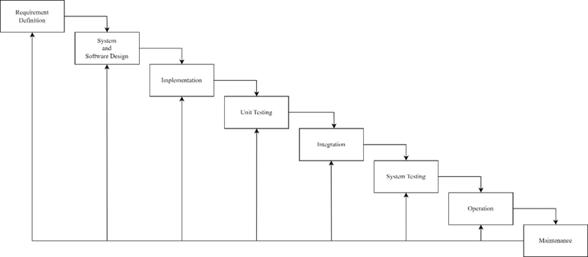
Methodology
WATERFALL MODEL

Slide 7
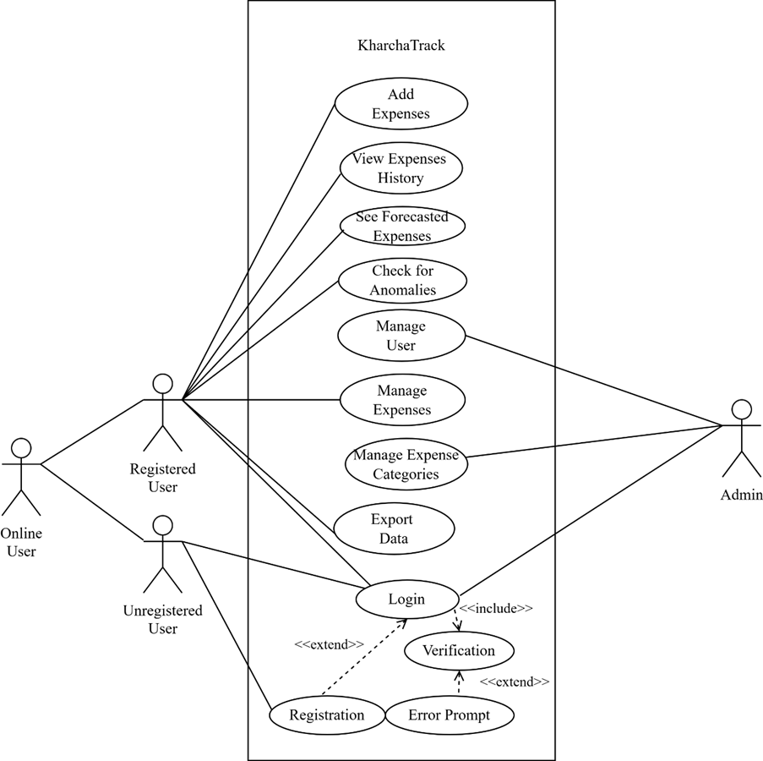
Architecture
USE CASE DIAGRAM

Slide 8
Features
User Management: Registration, authentication, email verification
Expense Tracking: CRUD expenses with automatic history logging
Category Management: Create and manage expense categories
Dashboard Analytics: Visual representation of spending patterns
Forecasting: Predict future expenses based on historical data
Anomaly Detection: Flag unusual spending patterns
Admin Panel: Comprehensive user and permission management

Slide 9
Description of Algorithm
Moving Average Algorithm
Analyzes historical expense data
Calculates spending trends over time
Generates future expense predictions
Helps users plan budgets effectively
Anomaly Detection Algorithm
Uses statistical analysis to identify outliers
Flags transactions that deviate significantly from normal patterns
Provides confidence scores for detected anomalies
Enhances security by identifying potential fraud

Slide 10
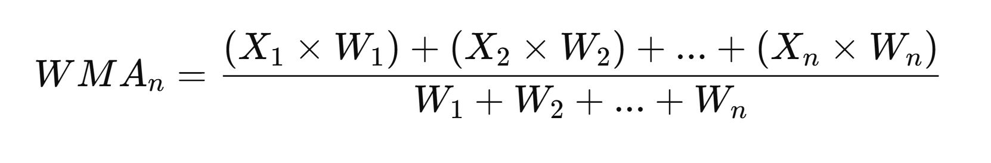
Formula for Forecasting
Weighted Moving Average Algorithm (Expense Forecasting)

Slide 11
Moving Average
public function calculateMovingAverage($expenses, $period = 3) {
$amounts = $expenses->pluck('amount')->toArray();
$movingAverages = [];
for ($i = $period - 1; $i < count($amounts); $i++) {
$sum = 0;
for ($j = 0; $j < $period; $j++) {
$sum += $amounts[$i - $j];
}
$movingAverages[] = $sum / $period;
}
return $movingAverages;
}

Slide 12
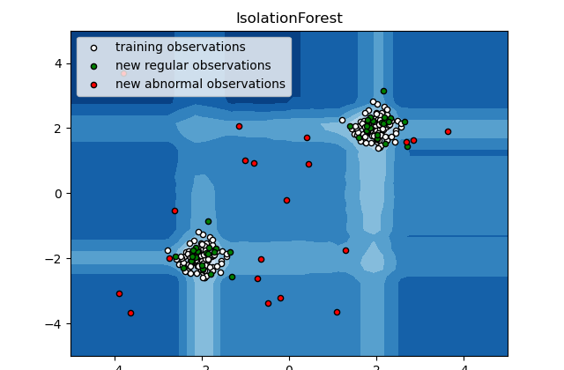
Isolation Forest Algorithm (Anomaly Detection)
Regular occurring expenses are clustered together.
Abnormal expenses are scattered.

Slide 13
Isolation Forest
public function detectAnomalies($expenses) {
$amounts = $expenses->pluck('amount')->toArray();
$mean = array_sum($amounts) / count($amounts);
$stdDev = $this->calculateStdDev($amounts, $mean);
foreach ($expenses as $expense) {
$zScore = ($expense->amount - $mean) / $stdDev;
if (abs($zScore) > 2.0) {
// Flag as anomaly
$this->createAnomalyRecord($expense, $zScore);
}
}
}

Slide 14

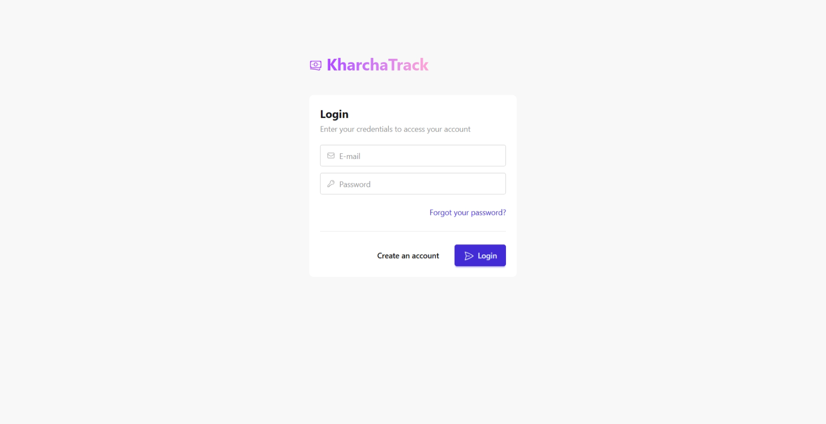
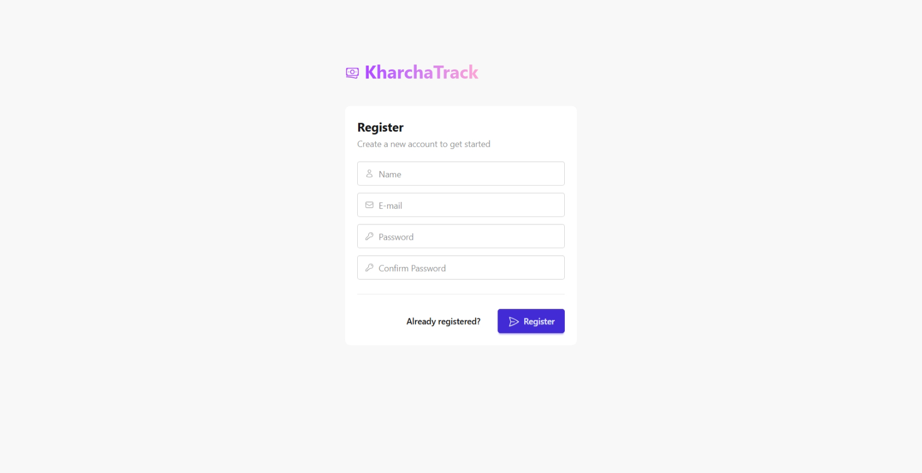
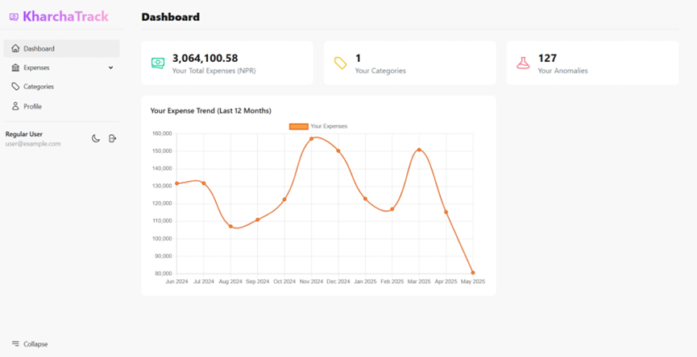
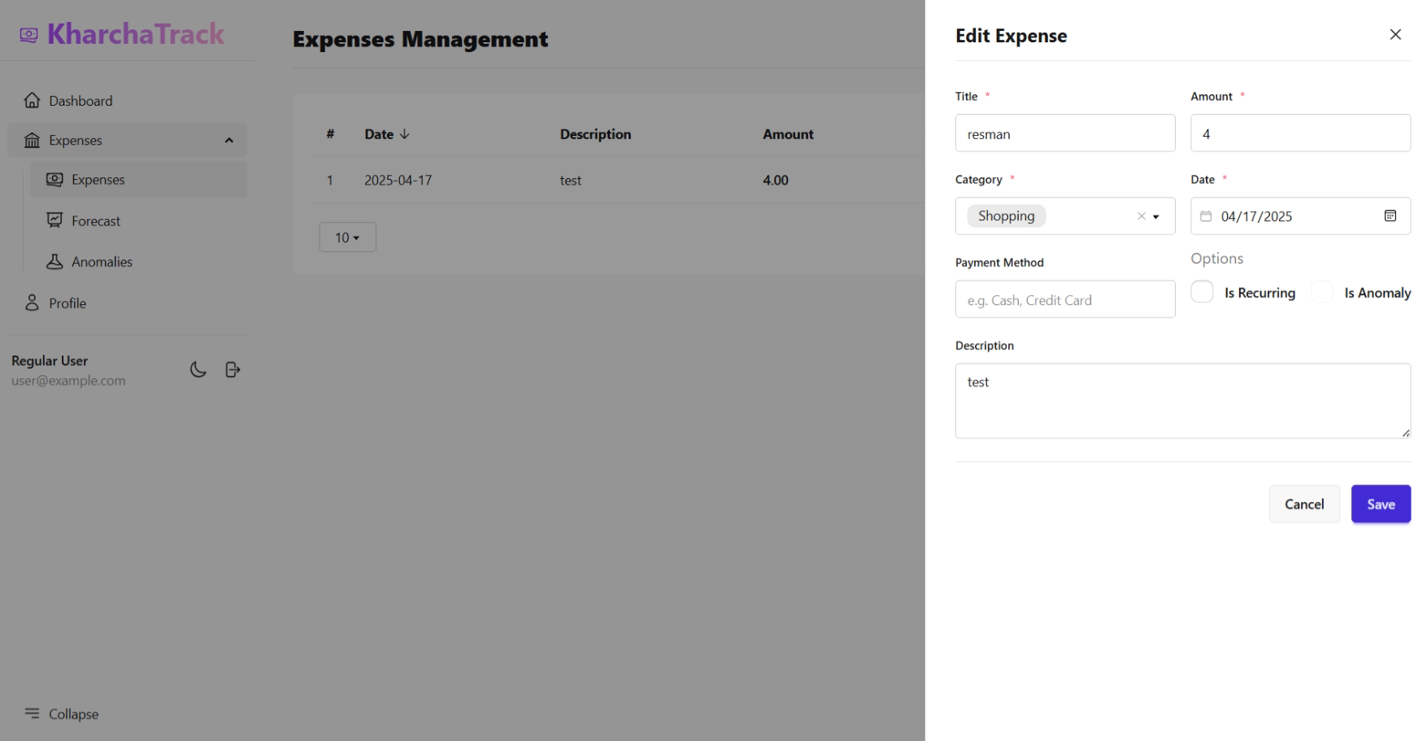
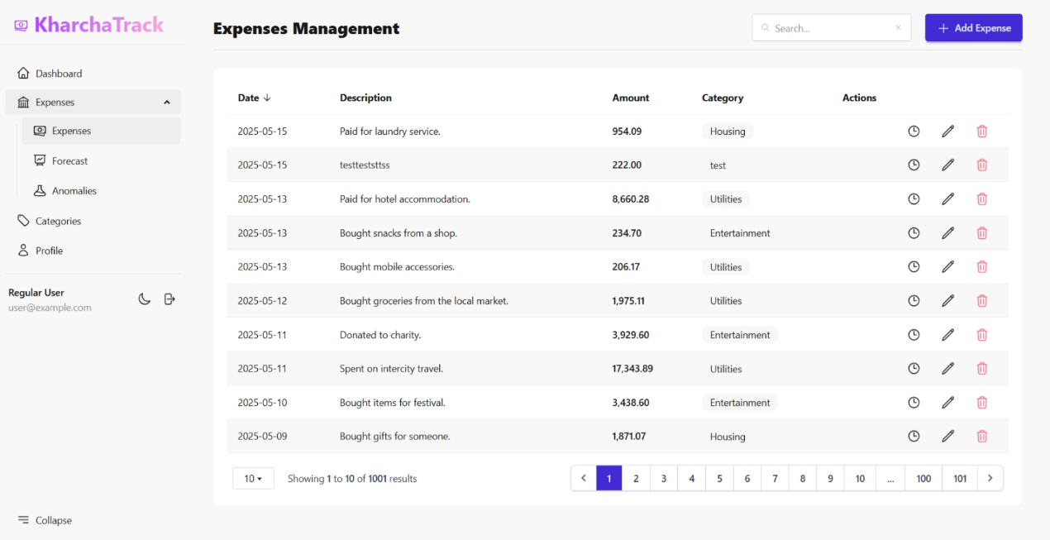
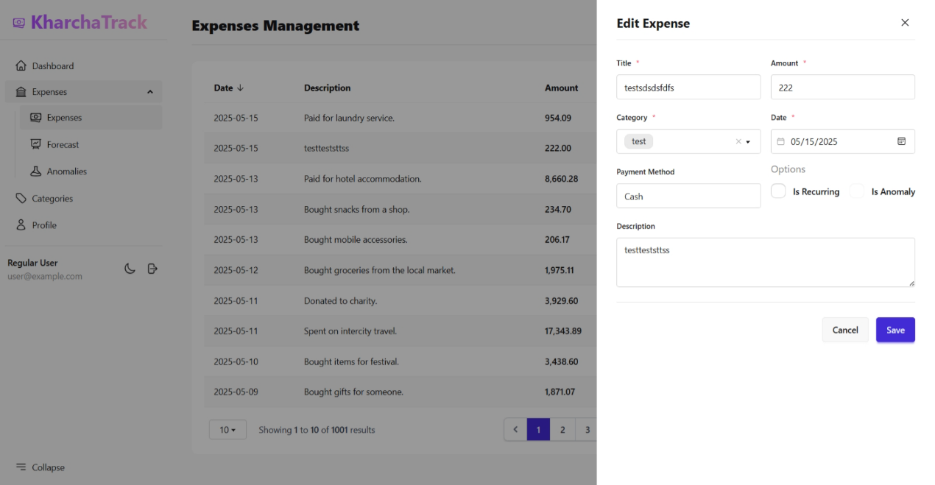
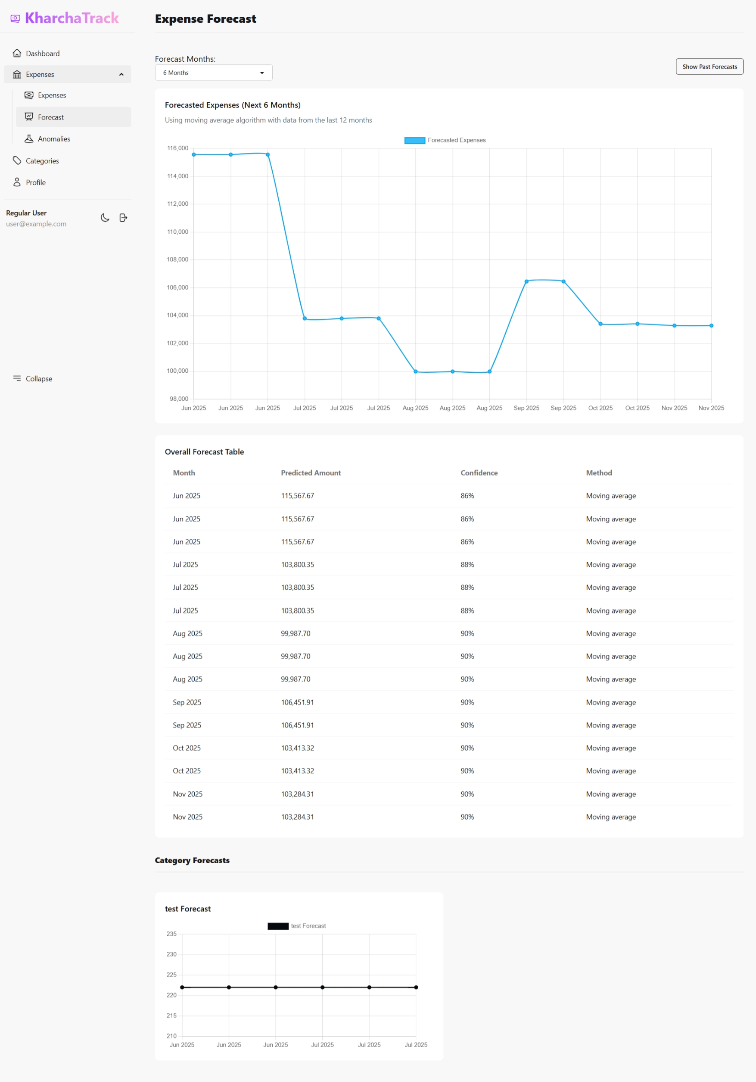
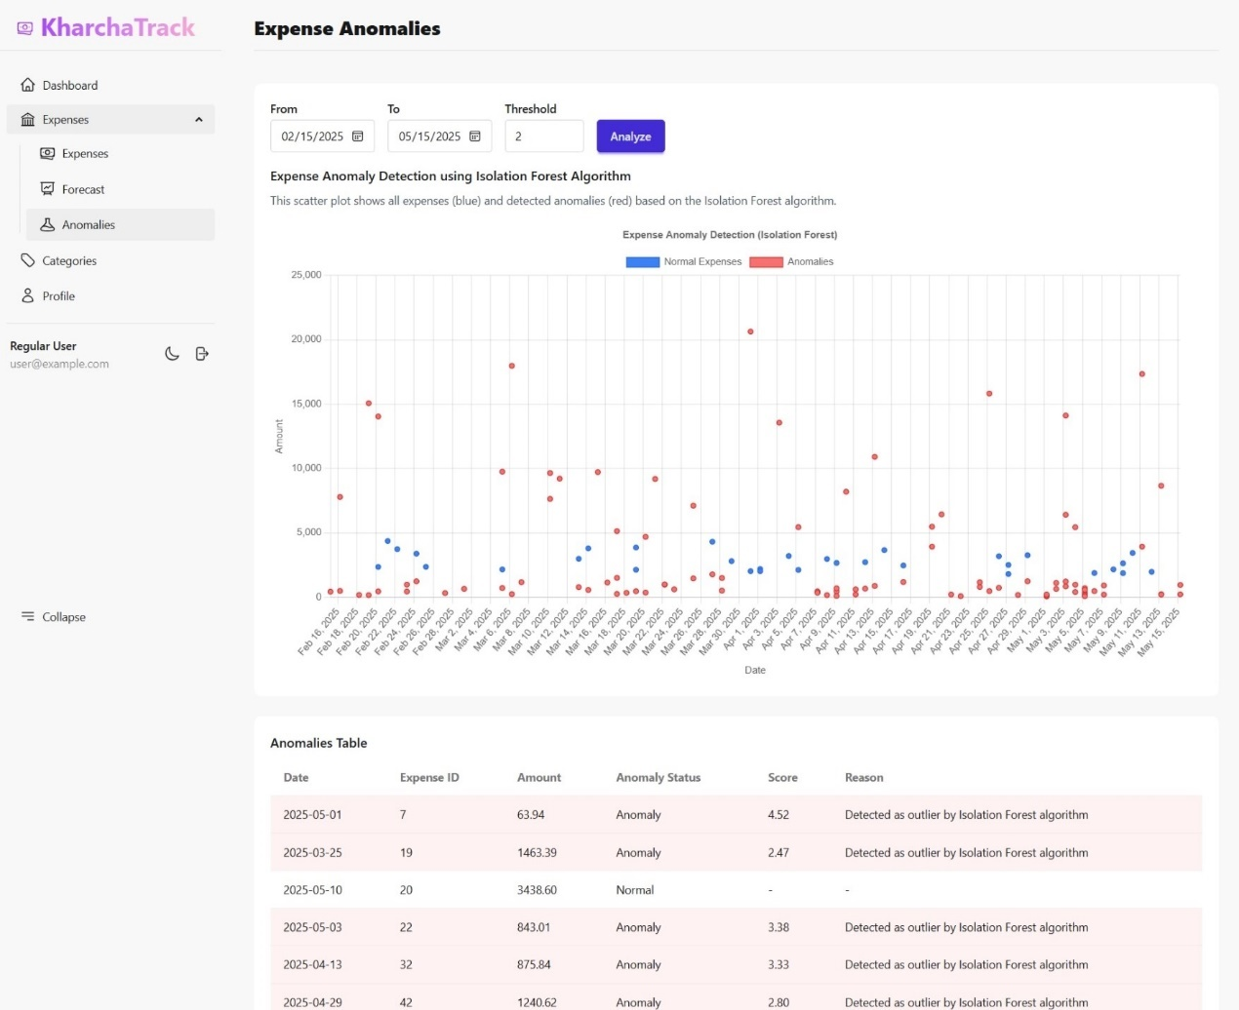
Screenshots

Slide 16
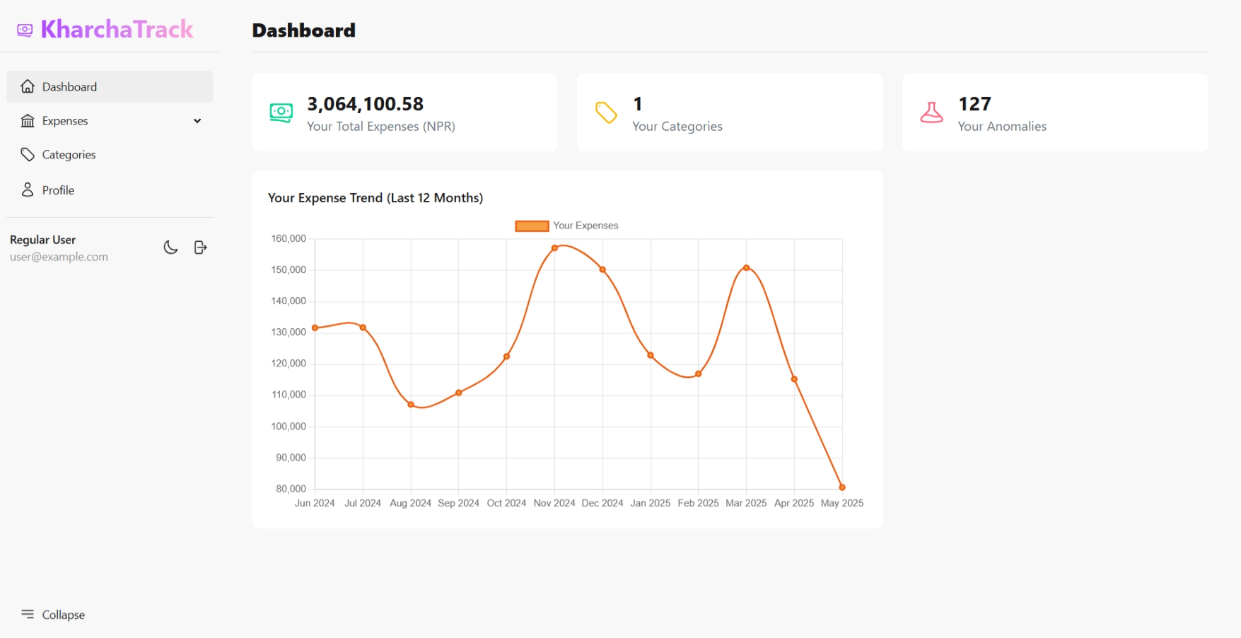

Slide 17
Conclusion
Successfully developed KharchaTrack as a comprehensive expense tracking solution with predictive capabilities
Implemented algorithms for forecasting and anomaly detection to provide meaningful financial insights
Created an intuitive and responsive web application that addresses financial management challenges

Slide 18
Thank You
Any queries?

